Slide 1



Slide 2

Python dictionary is an unordered collection of items.
While other compound data types have only value as an element, a dictionary has a key: value pair.
Dictionaries are optimized to retrieve values when the key is known.

Slide 3

○ Creating a dictionary is as simple as placing items inside
curly braces {} separated by comma.
Each element in a dictionary is represented by a key:value pair.
While values can be of any data type and can repeat,
keys must be of immutable type and must be unique.
3

Slide 4
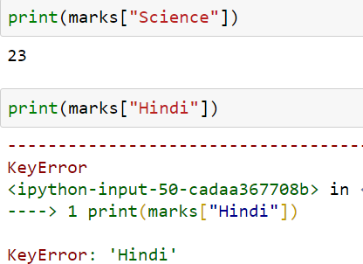
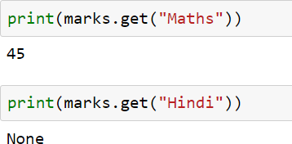
While indexing is used with other container types to access values, dictionary uses keys. Key can be used either inside square brackets or with the get() method.
The difference while using get() is that it returns None instead of KeyError, if the key is not found.

Slide 5

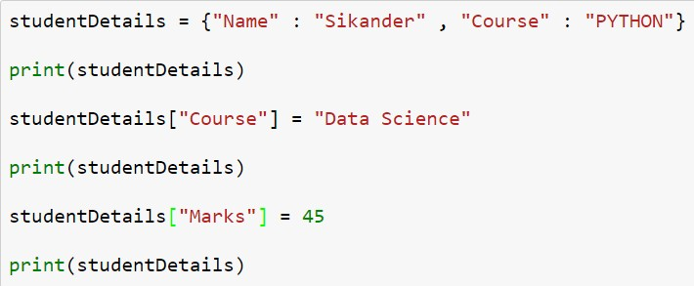
Dictionary are mutable. We can add new items or change the value of existing items using assignment operator.
If the key is already present, value gets updated, else a new key: value pair is added to the dictionary.

Slide 6
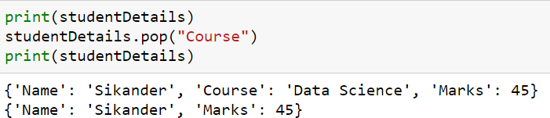
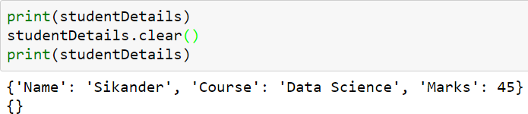
We can remove a particular item in a dictionary by using the method pop(). This method removes as item with the provided key and returns the value.
All the items can be removed at once using the clear() method.
We can also use the del keyword to remove individual items or the entire dictionary itself.

Slide 7
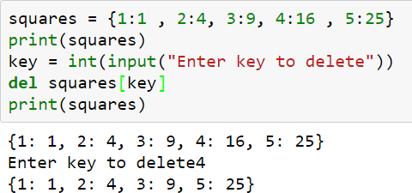

Slide 8
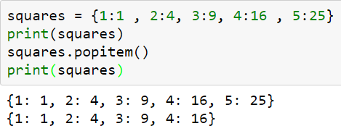
The method, popitem() can be used to remove and return an
arbitrary item (key, value) form the dictionary.
Raises KeyError if the dictionary is empty.

Slide 9
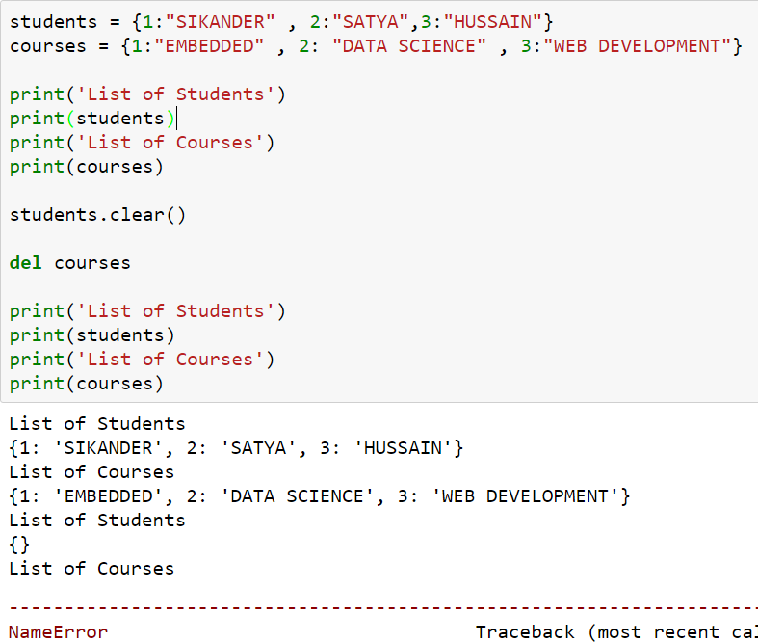

Slide 10
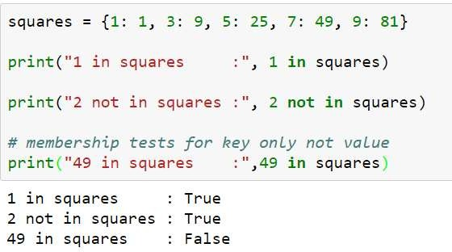
○ We can test if a key is in a dictionary or not using the keyword in. Notice that membership test is for keys only, not for values.

Slide 11
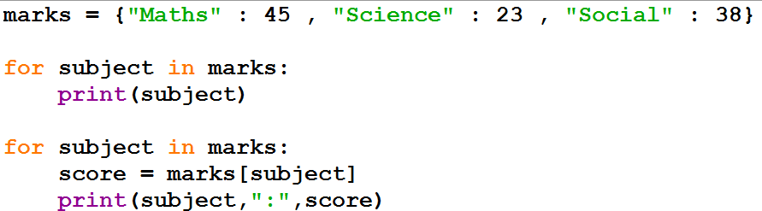
○ Using a for loop we can iterate through each key in a dictionary.

Slide 12
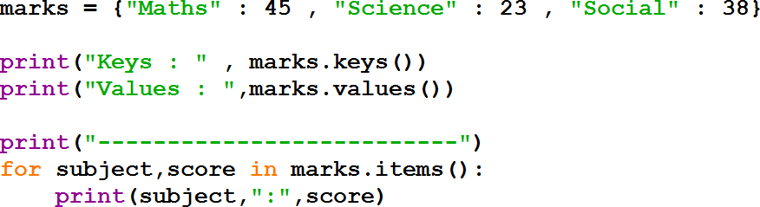

Slide 13
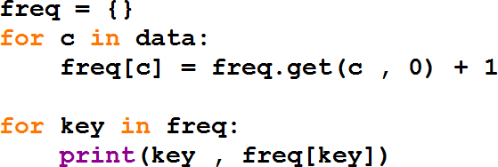

Slide 14
Method | Description
clear() | Remove all items form the dictionary.
copy() | Return a shallow copy of the dictionary.
fromkeys(seq[, v]) | Return a new dictionary with keys from seq and value equal to v(defaults to None).
get(key[,d]) | Return the value of key. If key doesnot exit, return d (defaults to None).
items() | Return a new view of the dictionary's items (key, value).
keys() | Return a new view of the dictionary's keys.
pop(key[,d]) | Remove the item with key and return its value or d if key is not found. If d is not provided and key is not found, raises KeyError.
popitem() | Remove and return an arbitary item (key, value). Raises KeyError if the dictionary is empty.
setdefault(key[,d]) | If key is in the dictionary, return its value. If not, insert key with a value of d and return d (defaults to None).
update([other]) | Update the dictionary with the key/value pairs from other, overwriting existing keys.
values() | Return a new view of the dictionary's values

Slide 15
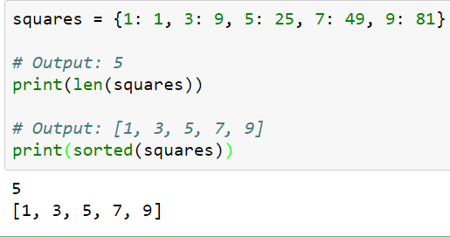
Function | Description
len() | Return the length (the number of items) in the dictionary.
sorted() | Return a new sorted list of keys in the dictionary.

Slide 16
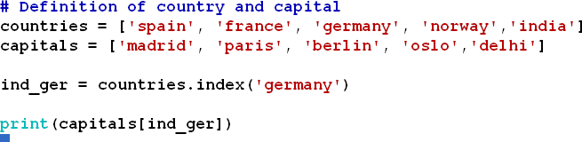
# Definition of country and capital
countries = ['spain', 'france', 'germany', 'norway','india']
capitals = ['madrid', 'paris', 'berlin', 'oslo','delhi']
I would like to print the capital of germany.
# Get index of 'germany': ind_ger
# Use ind_ger to print out capital of Germany

Slide 17


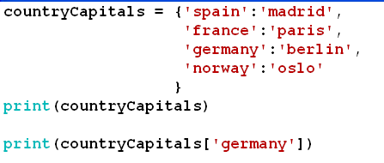

Slide 18
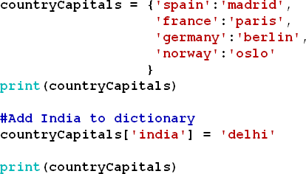
○ If you know how to access a dictionary, you can also assign a new value to it. To add a new key-value pair to countryCapitals, you can use something like this:
countryCapitals[‘india’] = ‘delhi’

Slide 19
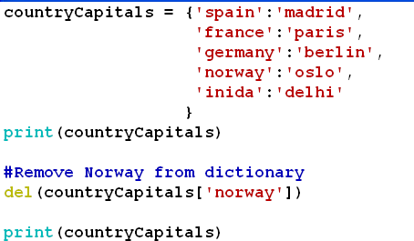
To remove a entry from dictionary, we can use del method.
Remove norway
del (countryCapitals[‘norway’])

Slide 20
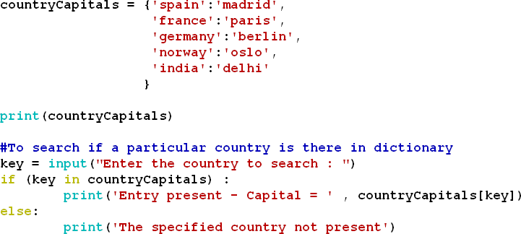

Slide 21
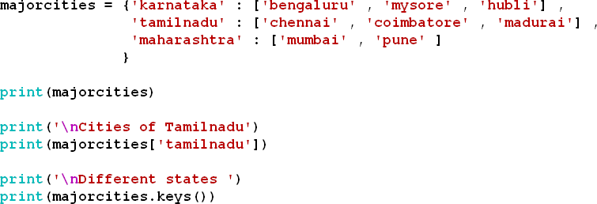
Create a Dictionary which records the major cities of each state.
{state : [major cities] }

Slide 22
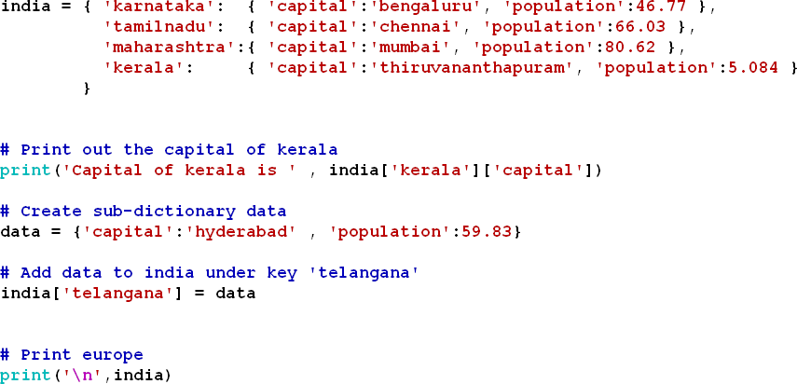
○ Dictionaries can contain key:value pairs where the values are again dictionaries.

Slide 23

